Slide 1
H2

Slide 2

H2
H2 Database Engine https://h2database.com/html/main.html
H2 is a relational DataBase Management System written in Java
can be used as an embedded database in Java applications or run in client–server mode
available as open source software

Slide 3
Installation
Downloads https://h2database.com/html/download.html
to install software, run installer or unzip it Platform-Independent Zip to a directory

Slide 4
should get following directory structure:
Directory | Contents
bin | JAR and batch files
docs | Documentation
docs/html | HTML pages
docs/javadoc | Javadoc files
ext | External dependencies (downloaded when building)
service | Tools to run the database as a Windows Service
src | Source files
src/docsrc | Documentation sources
src/installer | Installer, shell, and release build script
src/main | Database engine source code
src/test | Test source code
src/tools | Tools and database adapters source code

Slide 5
H2.bat
c:\jdk-25.0.1\bin\java.exe –cp
"h2-2.4.240.jar;%H2DRIVERS%;%CLASSPATH%" org.h2.tools.Console %*
@if errorlevel 1 pause

Slide 6
Using H2
H2 is open source, free to use and distribute
download: jar, installer (Windows), zip.
to start the H2 Console tool, double click the jar file, or run
  java -jar h2*.jar, h2.bat, or h2.sh
a new database is automatically created by default if embedded URL is used
closing last connection closes database

Slide 7
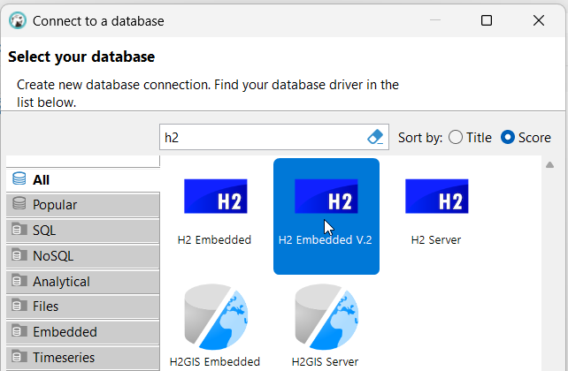
DBeaver client

Slide 8
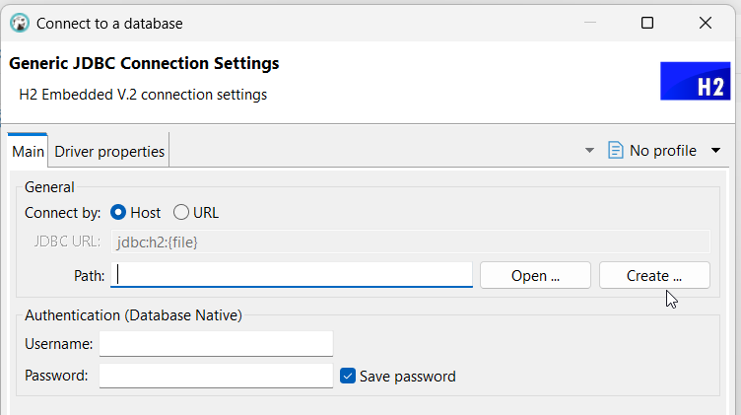
Create a new database

Slide 9
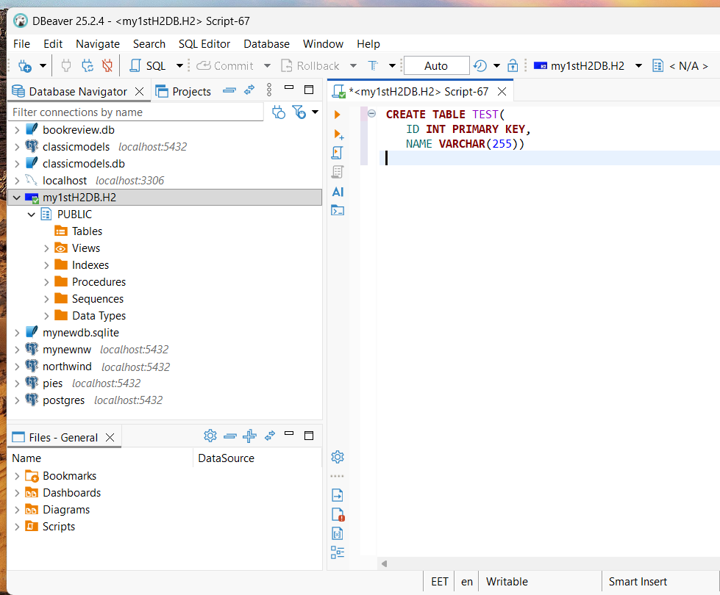

Slide 10
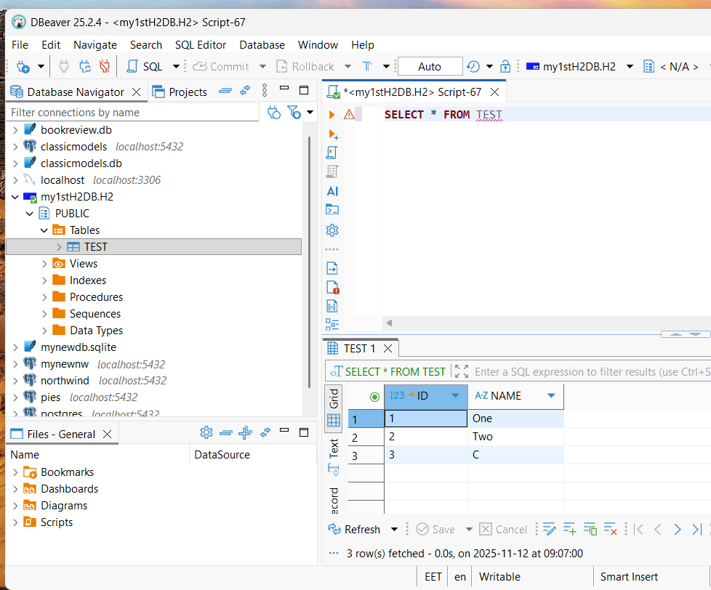

Slide 11


